Slide 1
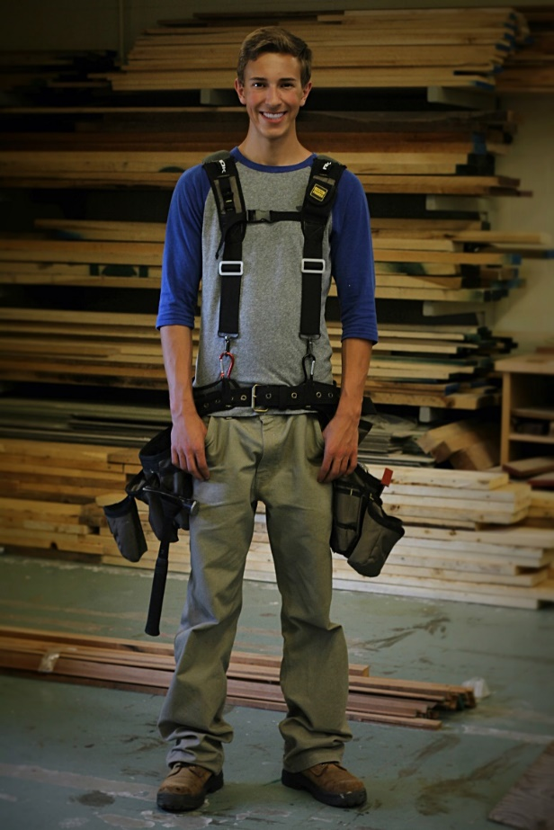
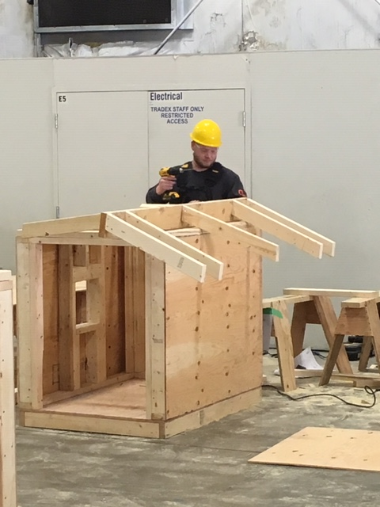
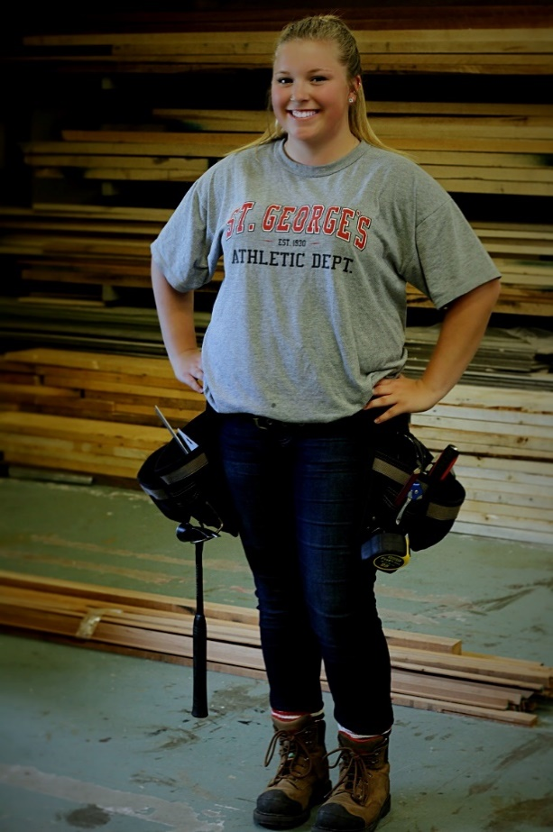
Trades Training Carpentry Program January 31 – June 24, 2022 SD43 Coquitlam + BCIT
Ryan
Nathan
January 19, 2022
Jaymee

Slide 2
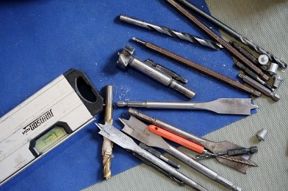
Introductions
Doug
Coquitlam School District
Rich Vickers, Carpentry Program Instructor
Doug MacLean, Career Programs (TRAIN in Trades) Coordinator
Joanna Horvath, WORK in Trades teacher
BCIT
John Akers, Carpentry Instructor (subject to change)
Don Naidesh, Chief Instructor
Carol Martina, High School Partnership Coordinator

Slide 3
Quick Points
Doug
Career-Life Connections (CLC 12)
Complete them through your home school… mandatory for graduation
Graduation
You will graduate from your home school
Commencement, Dinner & Dance, etc will not interfere with Terry Fox or BCIT learning… “Grad Weekend” does not mean 2-3 missed days of school
have a contact (best friend and counselor) at your home school to get information
Use the school app to get notifications

Slide 4
Quick Points
Doug
Credits & Marks
Ministry of Education – high school credits
registered in four grade 12 level courses (16 credits) that will all count towards graduation
five courses (20 credits) if you are in Work Experience 12
50% or higher in your final mark will be a “pass”
Industry Training Authority (ITA) – certification credits
for all trades, all levels, students must have a mark of 70% or higher to “pass” and gain that technical training certification level
Potential Certifications… students register themselves, not part of program
Occupational First Aid – level 1
1 day training… $80 + GST
Forklift
2-day training session… $175
Bobcat
1 day of training... $175-ish

Slide 5
Learning Sites
Doug
January 31 – February 4:
@ BCIT… some schools have Jan 31 as pro-d, but you will be at BCIT
February 7 – March 11:
@ Terry Fox
March 14 – March 25:
Spring Break… no school in session for the program… will look at maybe running a forklift and/or bobcat training sessions (depending on commitment)
March 28 – April 29:
@ BCIT
May 2 – June 24:
@ Terry Fox

Slide 6
Parental Involvement
Doug
While at Terry Fox
Like other high school courses you’ve had in the past at your home school, contact the teacher (Mr. Vickers) directly
While at BCIT:
BCIT instructor(John Akers) will talk about marks, absences, lates, tuition and other school-based information with the student and/or SD43 personnel
The parent “liaising” regarding the above is done through:
son or daughter, and/or
Rich Vickers
Doug MacLean

Slide 7
Individualized Education Plan
Doug
Students with IEPs:
Able to get a “reader” and/or “extra time”
While at Terry Fox, it will go through the Education Assistant (EA) there who will help facilitate this for the student
For BCIT, must make appointment with Accessibility Services
www.bcit.ca/accessibility
FYI, for levels 2,3 and 4:
ITA - need to make request/application for Exam Accommodation
Post secondary – talk to disability/accessibility resource services

Slide 8
Carpentry Program
Rich
Basic Information
Starts at 7.30am (both at Terry Fox + BCIT) and ends around 1.45pm, with appropriate breaks
Program cost: $425 for tools, materials & supplies + $100 refundable book deposit
‘Typical day’ look like?
“Classroom” (theory 60-70%) vs “Practical” (in the shop 30-40%)
Program evaluation
“Testing” – theory and practical assessments

Slide 9
Carpentry Program
Rich
Topics Covered
Line A (6%) – Safety Work Practices
Line B (16%) – Document & Organizational Skills
Line C (20%) – Tools & Equipment
Line D (6%) – Survey Instruments & Equipment
Line E (12%) – Access, Rigging & Hoisting Equipment
Line F (2%) – Site Layout
Line G (20%) – Concrete Formwork
Line H (16%) – Wood Frame Construction
Line J (2%) – Building Science

Slide 10
Carpentry Program
Rich
Being Successful in this whole Program
Absences & Lates… do not have any !
tell instructor, in advance… there is a “3-strike and you’re out” policy at BCIT
Maintaining your Grades… at least 70% !
Tests, Quizzes and other evaluations – both written and practical
Homework & Extra Studying
Extra help: from instructor and/or tutors
“School Supplies”
CSA approved safety boots + rain gear
Paper, Binder, Pens/Pencils & Ruler, calculator… just like other classes

Slide 11
Carpentry Program
Rich
Skills that will make you more successful in this Program
Being safe, always!
High degree of commitment and maturity
Solid grasp of basic numeracy and literacy skills
Self-motivated, self-reliant and self-advocating
Physical and mental abilities to perform the daily tasks associated with working in construction
Ability to work outdoors in all weather
Driving – get your “N”

Slide 12
Becoming a ‘Red Seal’
Doug
In order to become a Red Sealed Carpenter you will need two things:
Paid carpentry work… 6,360 hours registered with the Industry Training Authority (ITA)
Sponsor must have his/her Red Seal (or Cert of Apprenticeship)
Technical training… 4 levels
level 1 while in high school
subsequent 3 levels at BCIT, or other post secondary institutions that offer this training (7 weeks/level)

Slide 13
Youth ‘WORK’ in Trades
Joanna
When you get a paid job in a trade, ideally as a Carpenter, then we’ll help with the paperwork to get your registered with the ITA as an apprentice via “ITA reg form”
We’ll also help register your worked hours via “ITA Work-based Training Report”… these help towards certification

Slide 14
Great Opportunity
Doug
Tuition-free (23-week program after graduation ≅ $2,900… plus $1,300 books/supplies… application and other fees)
Avoid potential waiting lists
Gain your Level 1 technical training while still in grade 12
Others will be going to school next Sept… you’ll be working $$
$1,000 award if you have 900 work hrs, basically, before you turn 20
More employable and hirable… put this on resume
Great life-long skill
Following your Passion

Slide 15
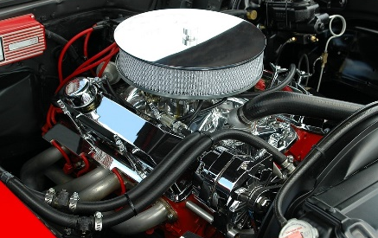
Contact Info
Doug
SD43 Contact information:
Rich Vickers, Carpentry Program teacher
RVickers@sd43.bc.ca
phone: 604-941-5401
Joanna Horvath, WORK in Trades teacher
JHorvath@sd43.bc.ca
phone/text: 604-312-7739
Doug MacLean, TRAIN in Trades coordinator
dmaclean@sd43.bc.ca
phone/text: 604-341-8977
www.43Careers.com > TRAIN > Carpentry

Slide 16
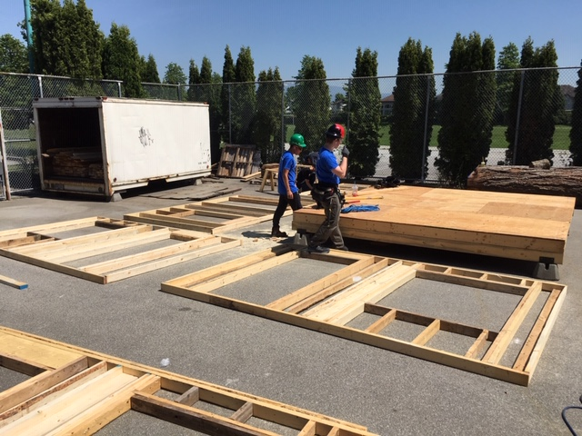
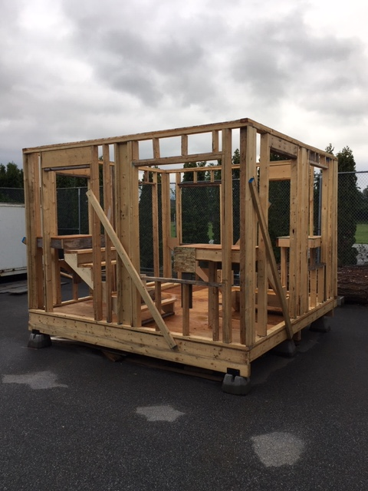

Slide 17
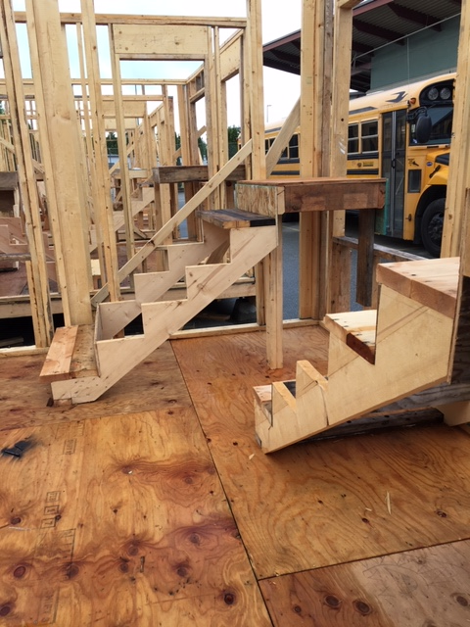
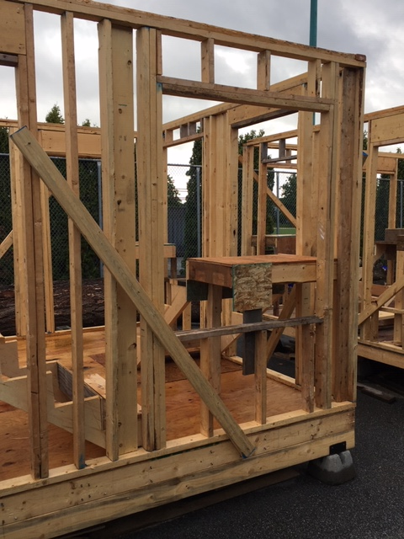

Slide 18
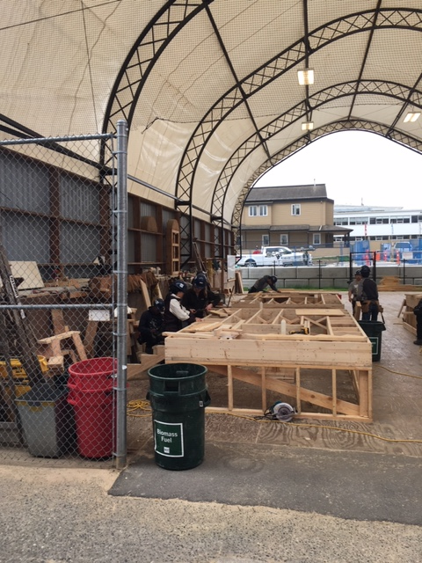

Slide 19
Questions / Comments
Anything you are still wondering about…

